Slide 1

Parallel Algorithm for Single-Source Shortest Paths
This presentation discusses a parallel algorithm template for updating single-source shortest paths (SSSP) in large-scale dynamic networks. The algorithm is designed to efficiently handle edge additions and deletions in real-time scenarios.
Authors: Arindam Khanda, Sriram Srinivasan, Sanjukta Bhowmick, Boyana Norris, Sajal K. Das
Presented by: Ali Ahmed, Manahil Ali, Afnan Hassan

Slide 2
Motivation for Dynamic SSSP
Real-world Networks
Traditional Algorithms
Parallel Design
Many networks are large and dynamic. They require fast, scalable updates.
Traditional SSSP algorithms are designed for static graphs. They are inefficient for dynamic environments.
Platform-independent parallel algorithm design is essential for speed and scalability.

Slide 3
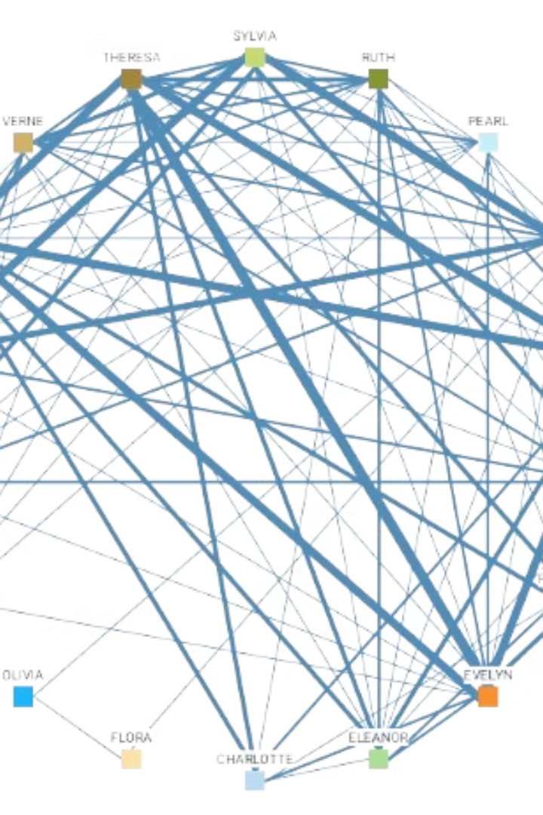
Problem Definition
SSSP Problem
Dynamic Graphs
Find shortest paths from a source to all other vertices in a graph.
Networks where edges can be added or deleted over time, changing the graph structure.
Objective
Efficiently update the SSSP tree as the graph evolves with minimal recomputation.

Slide 4

Key Contributions
Platform-Independent Framework
Rooted Tree Structure
Uses a rooted tree to store SSSP and detect affected subgraphs efficiently. Disconnect outdated parts quickly.
Parallel framework for SSSP updates in dynamic networks. Designed to minimize synchronization overhead.
Iterative Convergence
Outperforms state-of-the-art recomputing solutions. Achieves significant speedups.

Slide 5




Framework Overview
Identify Affected Subgraphs
Detect vertices impacted by edge updates.
Update Affected Areas
Disconnect outdated parts and iteratively reconnect.
Key Data Structures
Dist, Parent, Affected, Affected_Del

Slide 6

Limitations of the Original Approach
CUDA-Specific GPU Implementation
Shared-Memory Scaling
The original GPU implementation is limited to NVIDIA GPUs. Not very portable.
Shared-memory approach doesn't scale beyond a single node.
No Distributed Memory
The original algorithm lacks distributed-memory or partitioning techniques.

Slide 7

Proposed Parallelization Strategy
MPI for Inter-Node
Extend and generalize the parallel framework using MPI.
OpenMP/OpenCL Intra-Node
Leverage OpenMP and OpenCL for parallelism within nodes.
METIS Graph Partitioning
Use METIS for graph partitioning across different nodes.

Slide 8
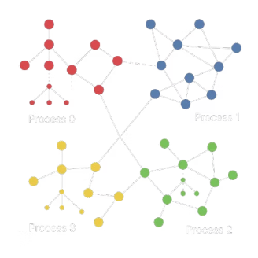



Graph Partitioning with METIS
MPI Process
2
Each MPI process handles one partition of the graph.
Balanced Parts
1
Partition graph into k balanced parts.
3
Minimal Communication
Ensure minimal communication between partitions with METIS.

Slide 9




MPI collectives used for convergence detection.
Inter-Node Parallelism with MPI
Local SSSP Tree
Identify Subgraphs
Communication
Each MPI process maintains its local SSSP tree.
Use MPI_Send/Recv to propagate distance updates.
Exchange affected vertices information.
Identify affected subgraphs in its own partition.
MPI collectives used for convergence detection.

Slide 10
Intra-Node Parallelism
OpenMP (CPU nodes)
OpenCL (Heterogeneity)
#pragma omp parallel for
Device-agnostic execution for
Updating affected vertices
Traversing adjacency lists.
Edge relaxations and distance updates
Flexible deployment on CPUs, GPUs, FPGAs
Dynamic scheduling handles load imbalance from uneven subgraphs.

Slide 11

Benefits of the Proposed Strategy
Discover the advantages of our approach:
Scalability across clusters using MPI + METIS
Flexible intra-node execution with OpenMP/OpenCL.
Maintains local subgraph updates.
Reduces recomputation, minimize communication, and avoid synchronization bottlenecks.

Slide 12

Challenges & Mitigations
Challenge
Mitigation
Load imbalance
Dynamic OpenMP scheduling, partition refinement
Communication overhead
METIS minimization, async MPI ops
Cycle formation
Careful handling of disconnected subtrees
Convergence
Iterative global convergence check (MPI_Allreduce)

Slide 13

Summary
1
Paper provides a platform-independent parallel template for dynamic SSSP.
2
Efficient on both GPUs and shared-memory machines.
3
Our extension introduces distributed-memory scalability using MPI + METIS.
4
This hybrid model makes the algorithm suitable for exascale systems.

Slide 14

Q&A Session
Do you have any questions about our parallel algorithm for single-source shortest paths? We're here to provide clarification and insights.

